Slide 1
Signal processing
Chapter 2 Discrete-Time Signals and Systems

Slide 2
Chapter 2 Discrete-Time Signals and Systems
2.0 Introduction
2.1 Discrete-Time Signals: Sequences
2.2 Discrete-Time Systems
2.3 Linear Time-Invariant (LTI) Systems
2.4 Properties of LTI Systems
2.5 Linear Constant-Coefficient Difference Equations

Slide 3
Chapter 2 Discrete-Time Signals and Systems
2.6 Frequency-Domain Representation of Discrete-Time Signals and systems

Slide 4
2.0 Introduction
Signal: something conveys information
Signals are represented mathematically as functions of one or more independent variables.
Continuous-time (analog) signals, discrete-time signals, digital signals
Signal-processing systems are classified along the same lines as signals: Continuous-time (analog) systems, discrete-time systems, digital systems
Discrete-time signal
  Sampling a continuous-time signal
  Generated directly by some discrete-time process

Slide 5
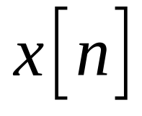
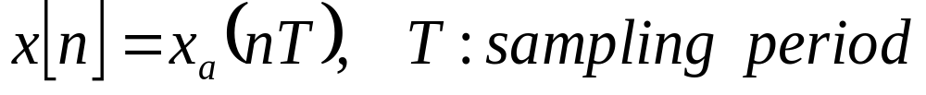
2.1 Discrete-Time Signals: Sequences
Discrete-Time signals are represented as
In sampling,
1/T (reciprocal of T) : sampling frequency
Cumbersome, so just use

Slide 6
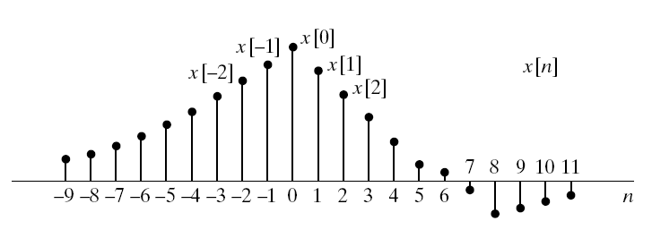
Figure 2.1 Graphical representation of a discrete-time signal
Abscissa: continuous line
: is defined only at discrete instants

Slide 7
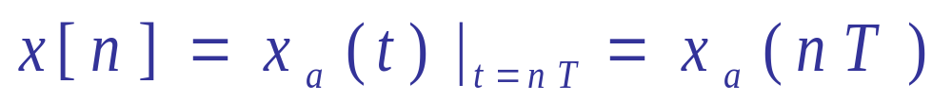
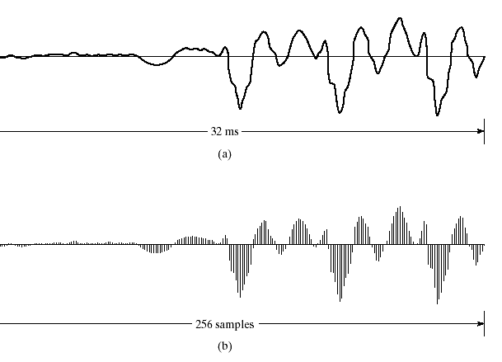
Sampling the analog waveform
EXAMPLE
Figure 2.2

Slide 8
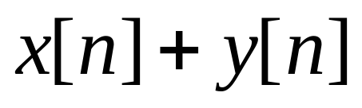
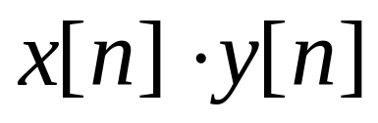
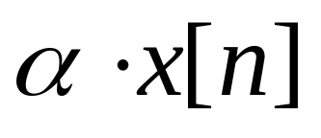
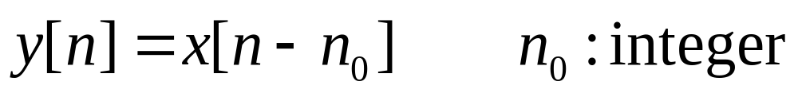
Basic Sequence Operations
Sum of two sequences
Product of two sequences
Multiplication of a sequence by a numberα
Delay (shift) of a sequence

Slide 9
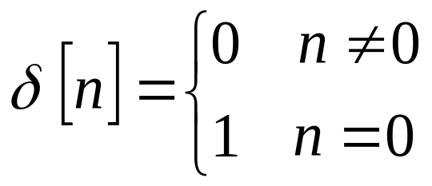
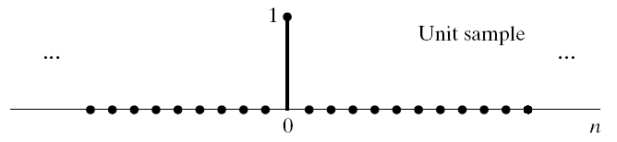
Basic sequences
Unit sample sequence (discrete-time impulse, impulse)

Slide 10
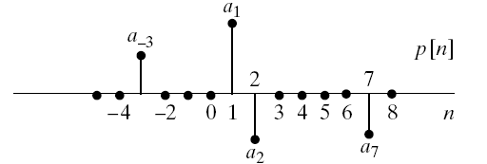
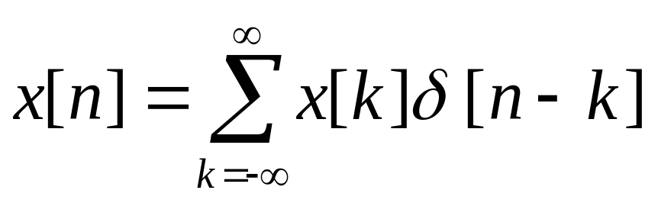
Basic sequences
A sum of scaled, delayed impulses
arbitrary sequence

Slide 11
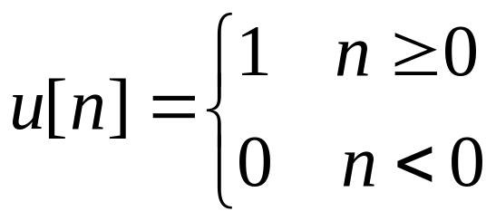
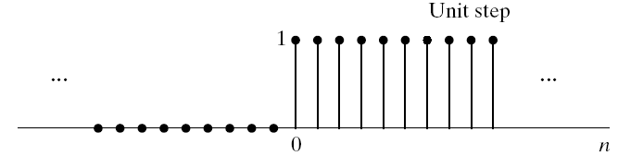
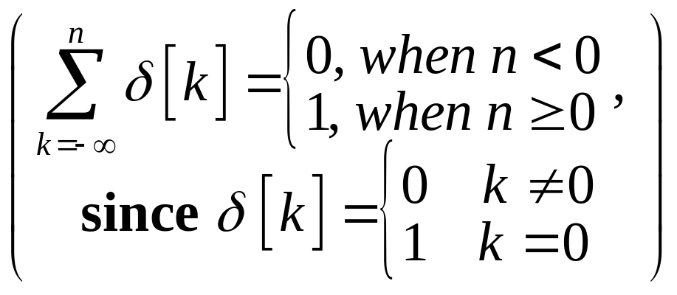
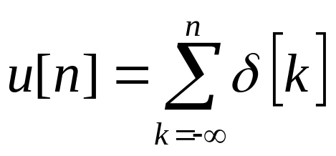
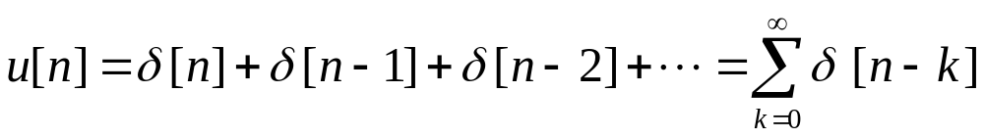

Basic sequences
Unit step sequence
First backward difference

Slide 12
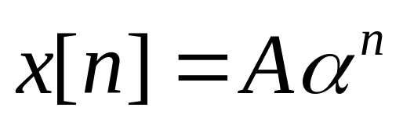
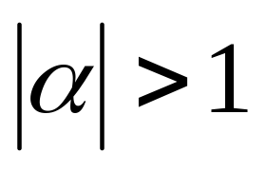
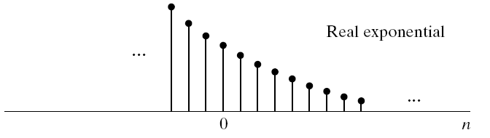
Basic Sequences
Exponential sequences
A and α are real: x[n] is real
A is positive and 0<α<1, x[n] is positive and decrease with increasing n
-1<α<0, x[n] alternate in sign, but decrease in magnitude with increasing n
: x[n] grows in magnitude as n increases

Slide 13
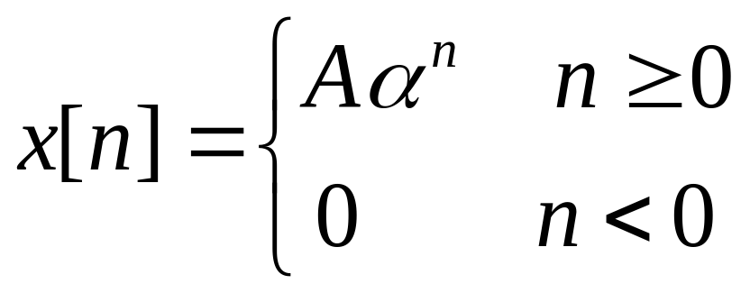
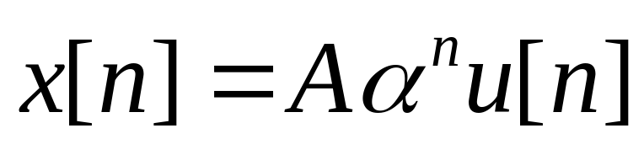
EX. 2.1 Combining Basic sequences
If we want an exponential sequences that is zero for n <0, then
Cumbersome
simpler

Slide 14
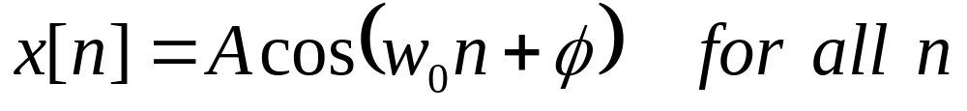
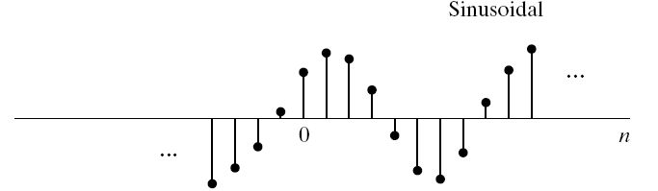
Basic sequences
Sinusoidal sequence

Slide 15
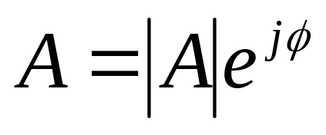
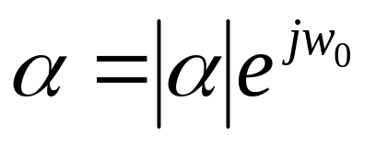
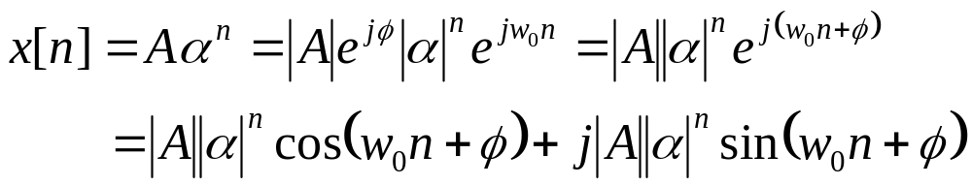
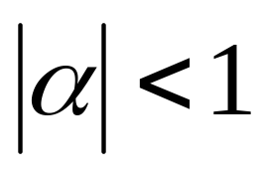
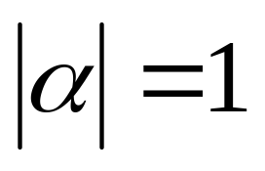
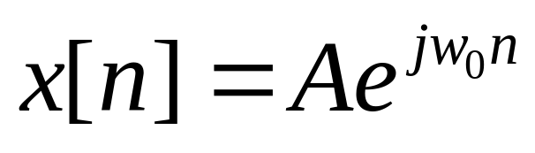
Exponential Sequences
Exponentially weighted sinusoids
Exponentially growing envelope
Exponentially decreasing envelope
is refered to
Complex Exponential Sequences

Slide 16
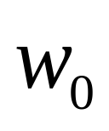

Frequency difference between continuous-time and discrete-time complex exponentials or sinusoids
: frequency of the complex sinusoid or complex exponential
: phase

Slide 17
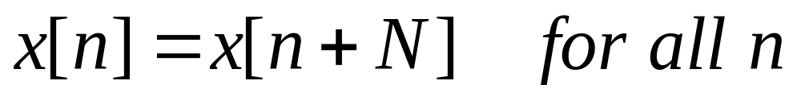
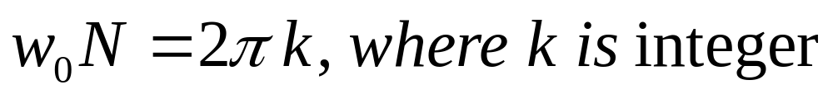
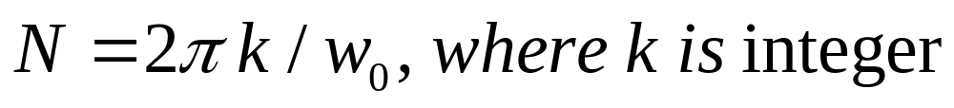
Periodic Sequences
A periodic sequence with integer period N

Slide 18
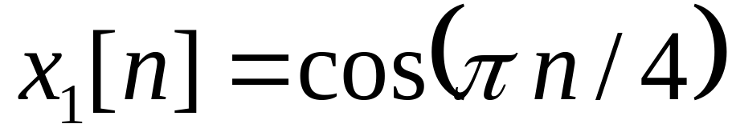
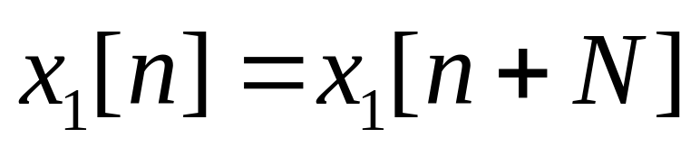
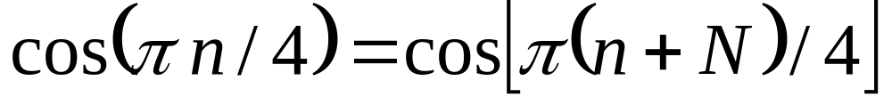
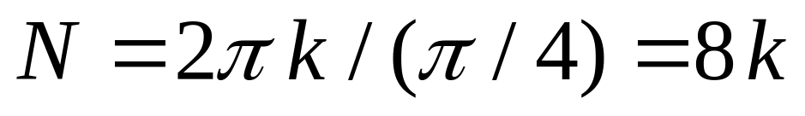
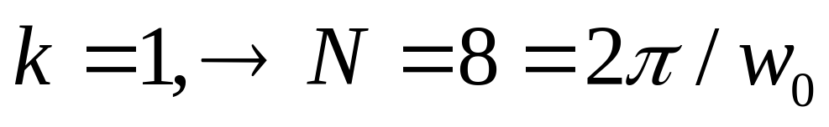
EX. 2.2 Examples of Periodic Sequences
Suppose it is periodic sequence with period N

Slide 19
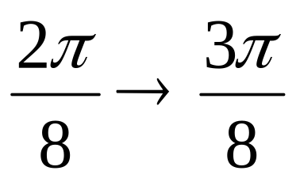
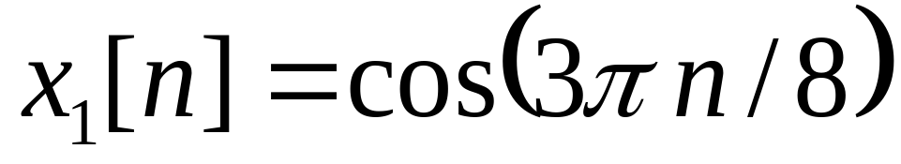
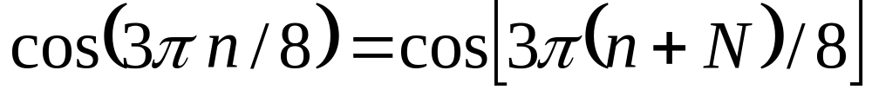
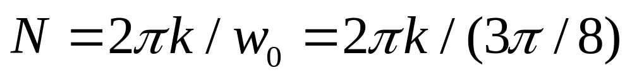
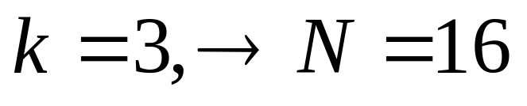
EX. 2.2 Examples of Periodic Sequences
Suppose it is periodic sequence with period N

Slide 20
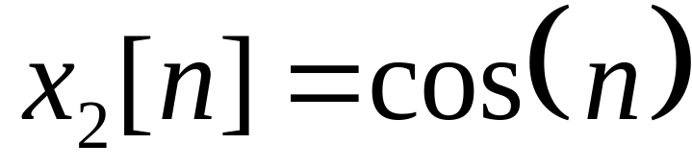
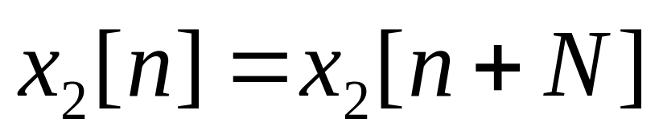
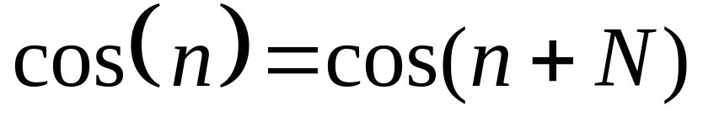
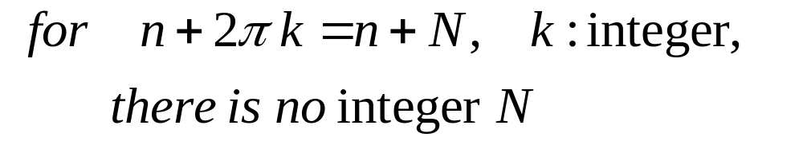
EX. 2.2 Non-Periodic Sequences
Suppose it is periodic sequence with period N

Slide 21
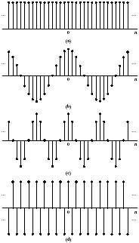

High and Low Frequencies in Discrete-time signal
(a) w₀ = 0 or 2π
(b) w₀ = π/8 or 15π/8
(c) w₀ = π/4 or 7π/4
(d) w₀ = π

Slide 22
2.2 Discrete-Time System
Discrete-Time System is a trasformation or operator that maps input sequence x[n] into a unique y[n]
y[n]=T{x[n]}, x[n], y[n]: discrete-time signal
x[n]
T{‧}
y[n]
Discrete-Time System

Slide 23




EX. 2.3 The Ideal Delay System
If is a positive integer: the delay of the system. Shift the input sequence to the right by samples to form the output .
If is a negative integer: the system will shift the input to the left by samples, corresponding to a time advance.

Slide 24


EX. 2.4 Moving Average
for n=7, M₁=0, M₂=5
dummy index m
x[m]
n-5
n
m

Slide 25

Effect of a moving average filter. (Sample values are connected by straight lines to enable easier viewing of stock exchange trends)

Slide 26

Properties of Discrete-time systems
2.2.1 Memoryless (memory) system
Memoryless systems:
the output y[n] at every value of n depends only on the input x[n] at the same value of n

Slide 27











Properties of Discrete-time systems
2.2.2 Linear Systems
If
T{‧}
T{‧}
and only If:
T{‧}
additivity property
T{‧}
homogeneity or scaling
property
principle of superposition
T{‧}

Slide 28





Example of Linear System
Ex. 2.6 Accumulator system
for arbitrary
when

Slide 29



Example 2.7 Nonlinear Systems
Method: find one counterexample
For
counterexample
For
counterexample

Slide 30


Properties of Discrete-time systems
2.2.3 Time-Invariant Systems
Shift-Invariant Systems
T{‧}
T{‧}

Slide 31


Example of Time-Invariant System
Ex. 2.8 Accumulator system

Slide 32



Properties of Discrete-time systems
2.2.4 Causality
A system is causal if, for every choice of , the output sequence value at the index depends only on the input sequence value for

Slide 33


Ex. 2.10 Example for Causal System
Forward difference system is not Causal
Backward difference system is Causal

Slide 34


Properties of Discrete-time systems
2.2.5 Stability
Bounded-Input Bounded-Output (BIBO) Stability: every bounded input sequence produces a bounded output sequence.
if
then

Slide 35

Ex. 2.11 Test for Stability or Instability
is stable
if
then

Slide 36


Ex. 2.11 Test for Stability or Instability
Accumulator system
Accumulator system is not stable

Slide 37
Properties of Discrete-time systems (Repeat)
2.2.2 Linear Systems
If
T{‧}
T{‧}
and only If:
T{‧}
additivity property
T{‧}
homogeneity or scaling
property
principle of superposition
T{‧}

Slide 38




2.3 Linear Time-Invariant (LTI) Systems
Impulse response
T{‧}
T{‧}

Slide 39


LTI Systems: Convolution
Representation of general sequence as a linear combination of delayed impulse
principle of superposition
An Illustration Example（interpretation 1）

Slide 40





Slide 41




Computation of the Convolution
（interpretation 2）
reflecting h[k] about the origion to obtain h[-k]
Shifting the origin of the reflected sequence to k=n

Slide 42


Ex. 2.12

Slide 43



Convolution can be realized by
  Reflecting h[k] about the origin to obtain h[-k].
  Shifting the origin of the reflected sequences to k=n.
  Computing the weighted moving average of x[k] by using the weights given by h[n-k].

Slide 44




Ex. 2.13 Analytical Evaluation of the Convolution
For system with impulse response
h(k)
input
0
Find the output at index n

Slide 45




h(-k)
h(k)
0
0
h(n-k)
x(k)
0

Slide 46


h(-k)
h(k)
0
0

Slide 47



h(-k)
h(k)
0
0

Slide 48



Slide 49

2.4 Properties of LTI Systems
Convolution is commutative
x[n]
h[n]
y[n]
h[n]
x[n]
y[n]
Convolution is distributed over addition

Slide 50

Cascade connection of systems
h₁[n]
h₂[n]
y [n]
x [n]
h₂[n]
h₁[n]
y [n]
x [n]
h₁[n] ]∗h₂[n]
y [n]
x [n]

Slide 51



Parallel connection of systems

Slide 52





Stability of LTI Systems
LTI system is stable if the impulse response is absolutely summable .
Causality of LTI systems
HW: proof, Problem 2.62

Slide 53

Impulse response of LTI systems
Impulse response of Ideal Delay systems
Impulse response of Accumulator

Slide 54

Impulse response of Moving Average systems

Slide 55


Impulse response of Forward Difference
Impulse response of Backward Difference

Slide 56

Finite-duration impulse response (FIR) systems
The impulse response of the system has only a finite number of nonzero samples.
such as:
The FIR systems always are stable.

Slide 57


Infinite-duration impulse response (IIR)
The impulse response of the system is infinite in duration.
Stable IIR System:

Slide 58




Equivalent systems

Slide 59



Inverse system

Slide 60

2.5 Linear Constant-Coefficient Difference Equations
An important subclass of linear time-invariant systems consist of those system for which the input x[n] and output y[n] satisfy an Nth-order linear constant-coefficient difference equation.

Slide 61




Ex. 2.14 Difference Equation Representation of the Accumulator

Slide 62


Block diagram of a recursive difference equation representing an accumulator

Slide 63
Difference Equation Representation of the System
An unlimited number of distinct difference equations can be used to represent a given linear time-invariant input-output relation.

Slide 64
Solving the difference equation
Without additional constraints or information, a linear constant-coefficient difference equation for discrete-time systems does not provide a unique specification of the output for a given input.

Slide 65









Solving the difference equation
Output:
Particular solution: one output sequence for the given input
Homogenous solution: solution for the homogenous equation( ):
where is the roots of

Slide 66


Example 2.16 Recursive Computation of Difference Equation

Slide 67





Example 2.16 Recursive Computation of Difference Equation

Slide 68






Periodic Frequency Response
The frequency response of discrete-time LTI systems is always a periodic function of the frequency variable with period
Signal Processing - Dr. Arif Wahla

Slide 69





Periodic Frequency Response
We need only specify over
The “low frequencies” are frequencies close to zero
The “high frequencies” are frequencies close to
More generally, modify the frequency with
, r is integer.
Signal Processing - Dr. Arif Wahla

Slide 70

Example 2.19 Ideal Frequency-Selective Filters
Frequency Response of Ideal Low-pass Filter
Signal Processing - Dr. Arif Wahla

Slide 71

Frequency Response of Ideal High-pass Filter

Slide 72

Frequency Response of Ideal Band-stop Filter

Slide 73

Frequency Response of Ideal Band-pass Filter

Slide 74


Example 2.20 Frequency Response of the Moving-Average System

Slide 75


Impulse response and Frequency response
The frequency response of a LTI system is the Fourier transform of the impulse response.

Slide 76
Chapter 2 HW
2.1, 2.4, 2.5, 2.7, 2.11, 2.12,2.15, 2.20

